Slide 1
Youth Works Northamptonshire
We are a Charitable Incorporated Organisation that delivers education and support services to the young people of Northamptonshire under 4 key strands:

Slide 2
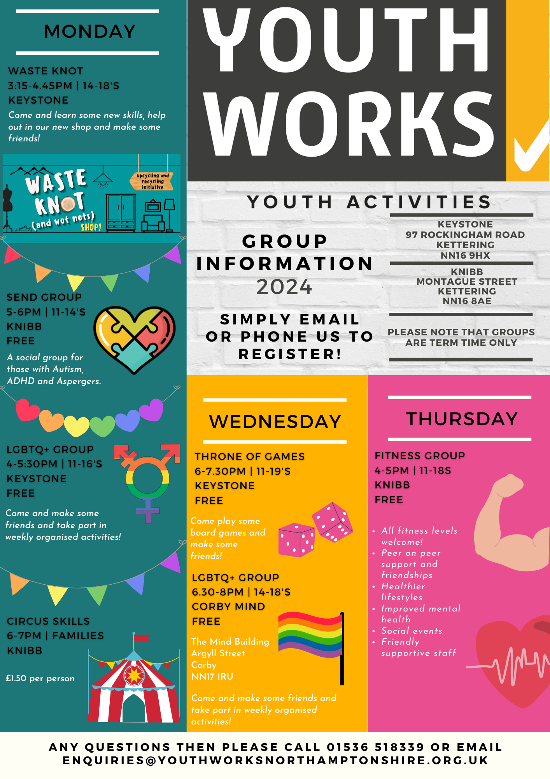
We offer 6 different weekly activity groups for young people in Kettering: LGBTQI+ SEND Circus Skills Throne of Games Waste Knot Sports Offering friendly safe spaces for young people to socialise, make friends and learn new skills

Slide 3
Mondays 3.15pm – 4.45pm (14-18 yrs.)
Saturdays 10am – 12pm (18 yrs. +)

Slide 4
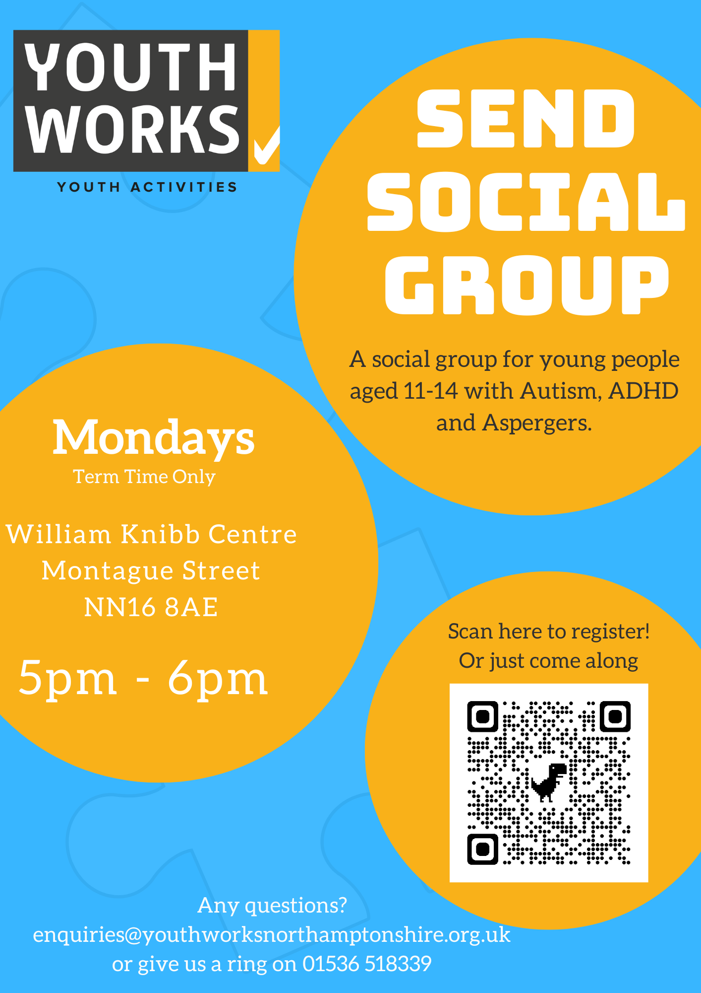
Mondays 3.15pm -M

Slide 5
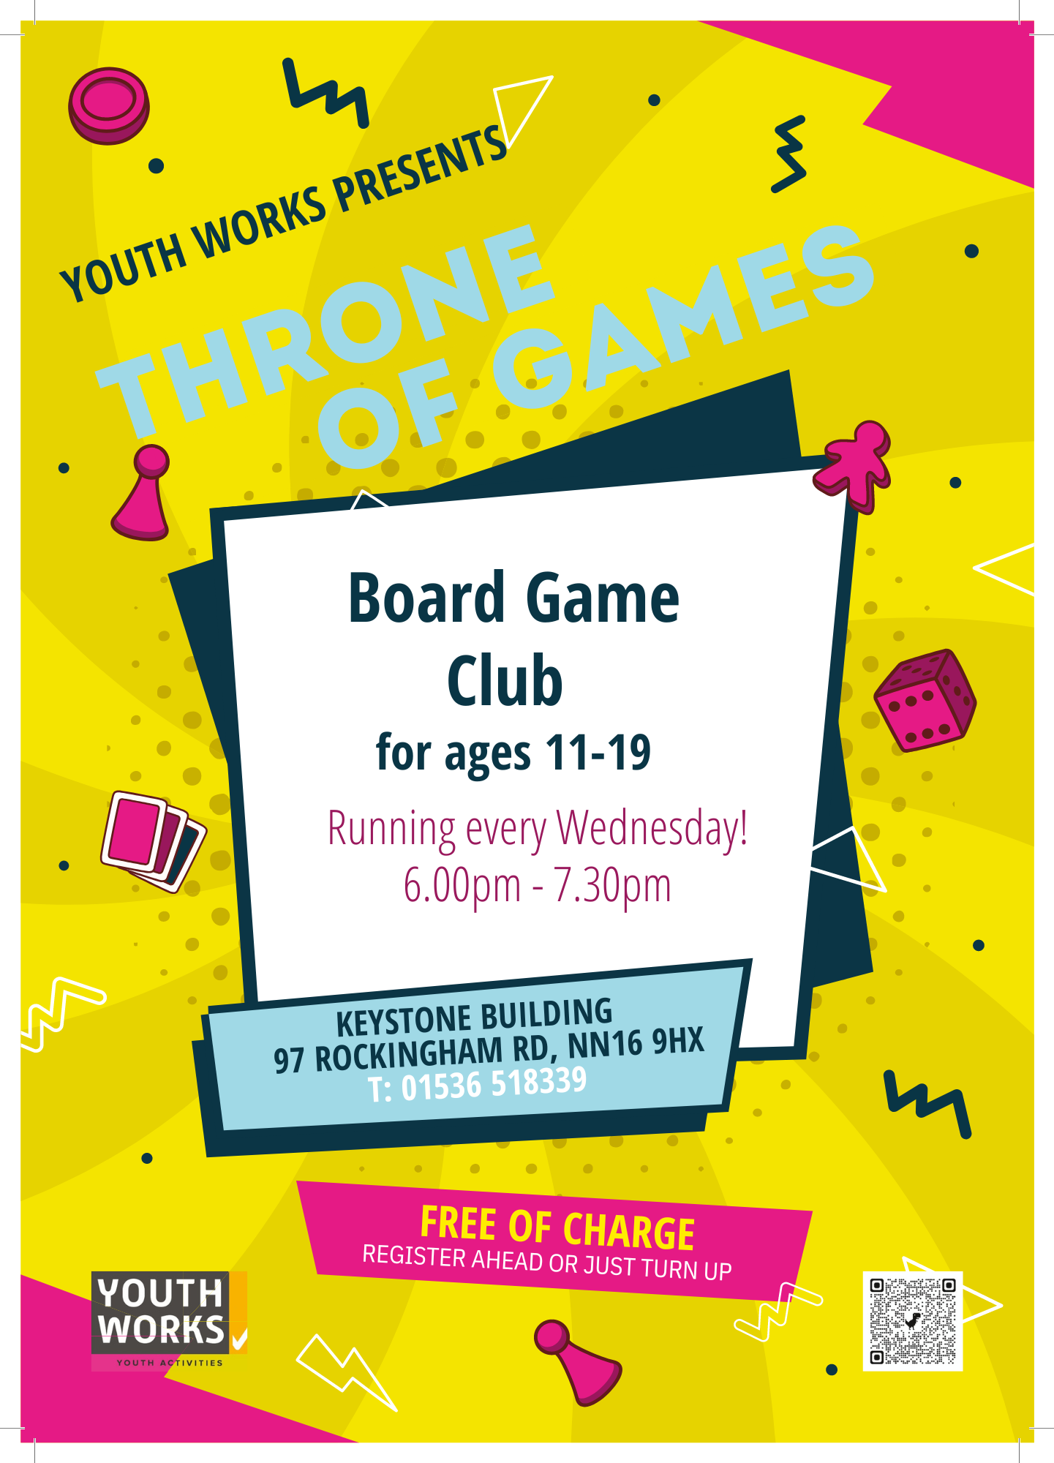

Slide 6
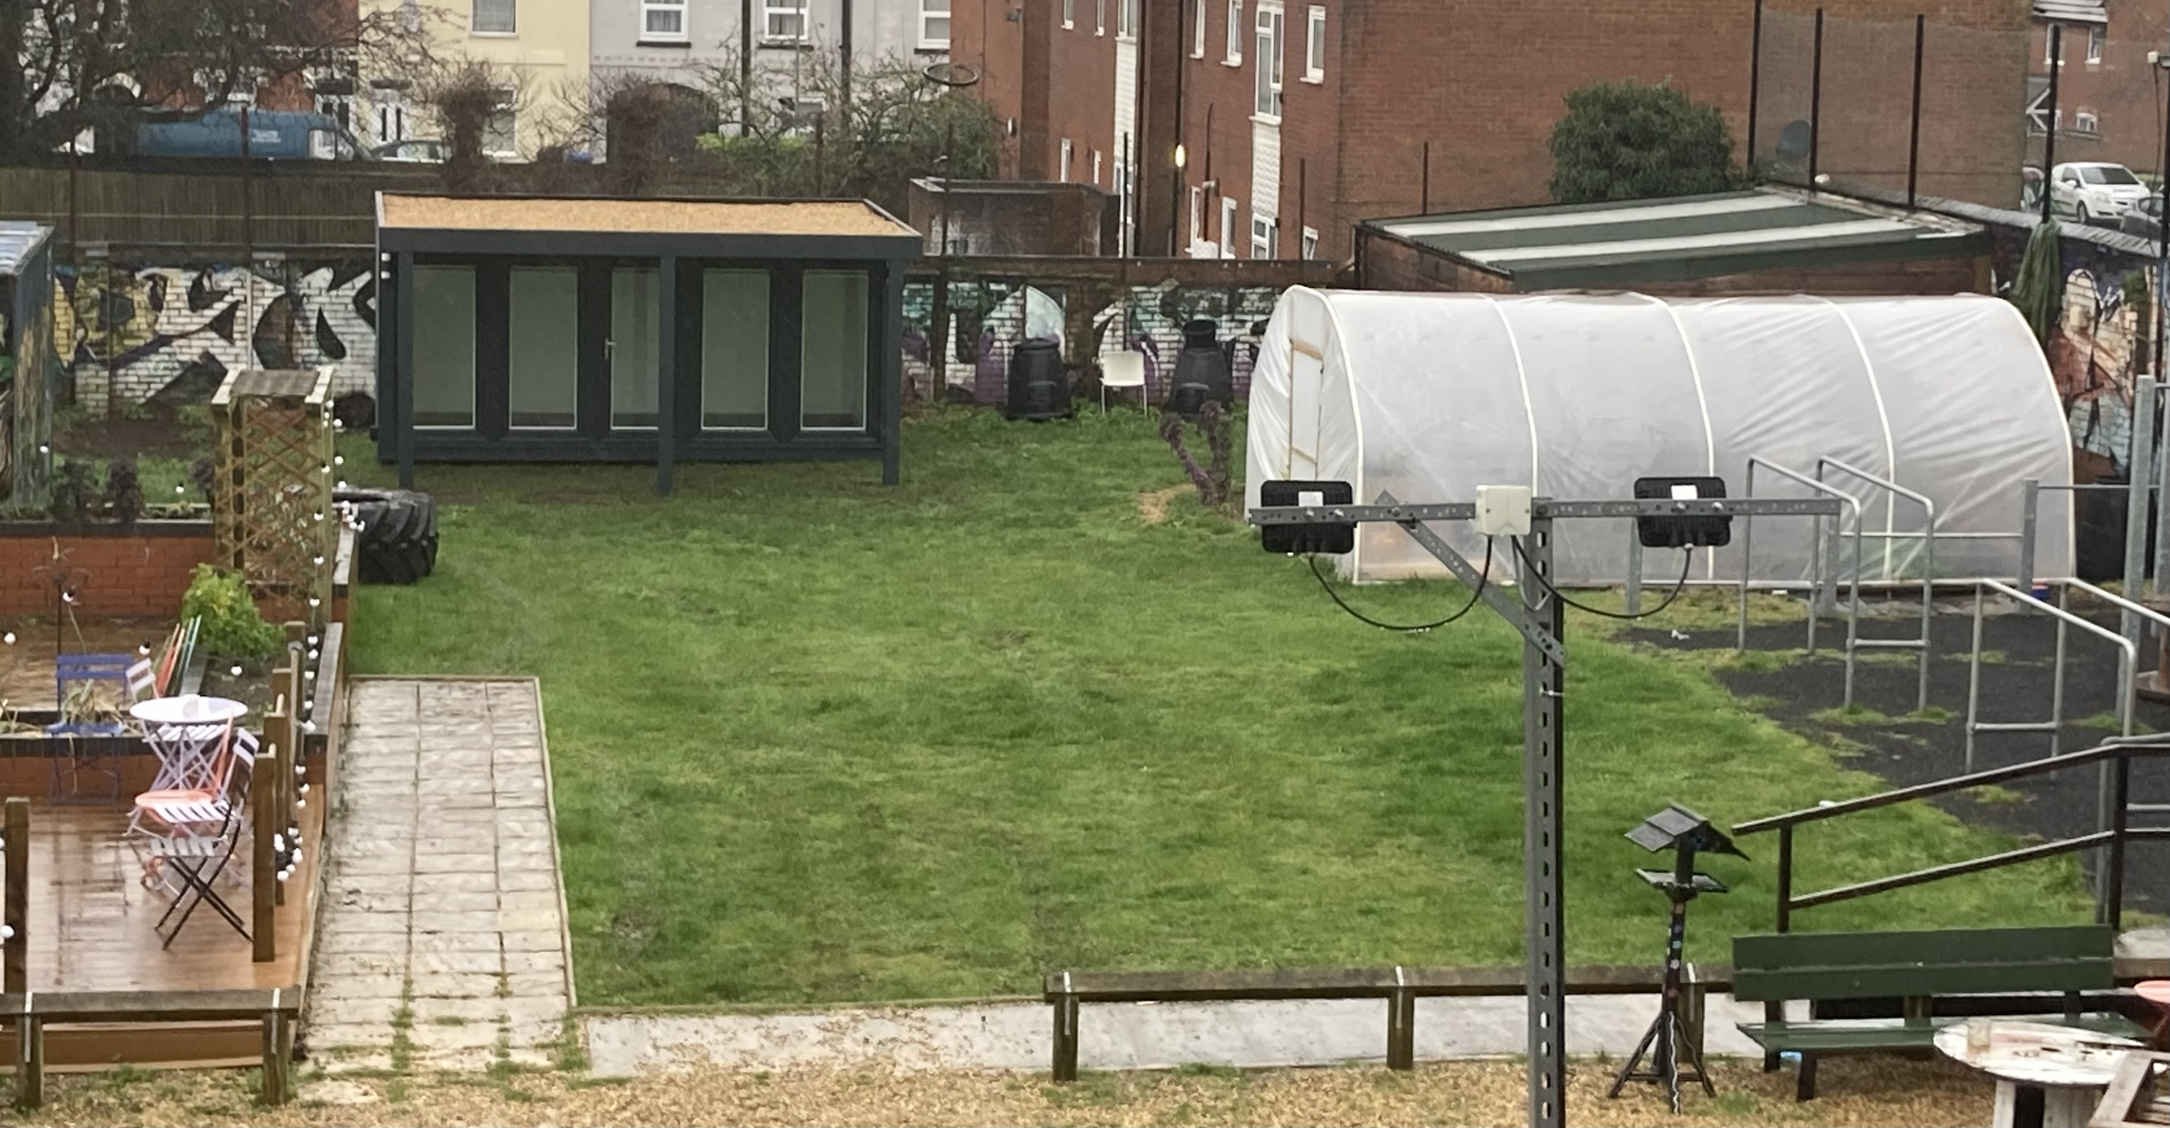
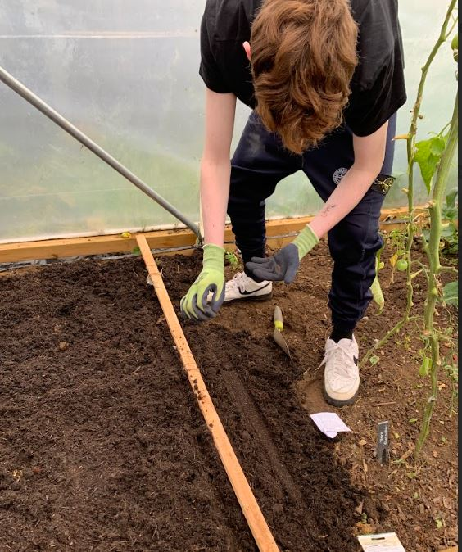
Coming soon:
Skateboarding
Horticulture
Funded through the
North Northamptonshire
Local Area Partnership

