Slide 1
Kettering Town Meeting Northamptonshire Scouts
21 February 2024

Slide 2
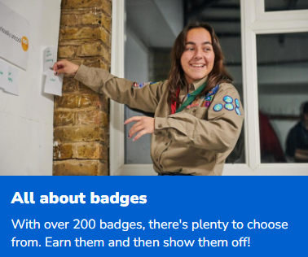
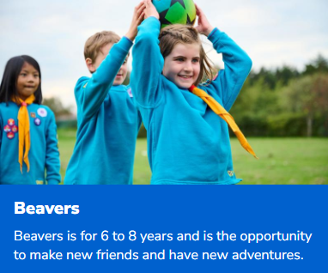
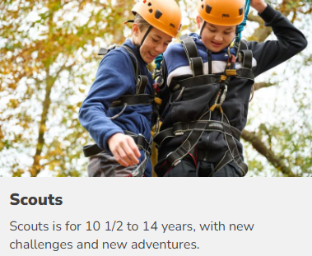
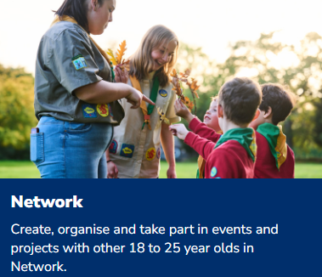
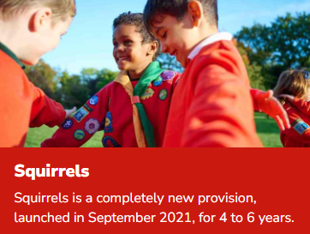
Our Mission: Scouting actively engages and supports young people in their personal development, empowering them to make a positive contribution to society
https://youtu.be/xXzGGSd3KFI

Slide 3
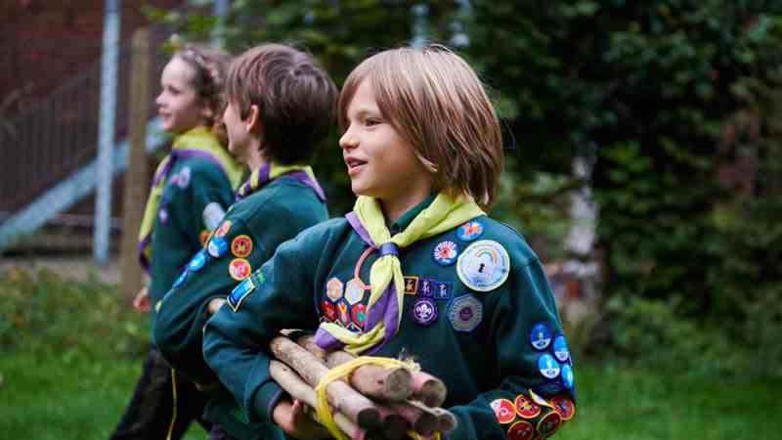
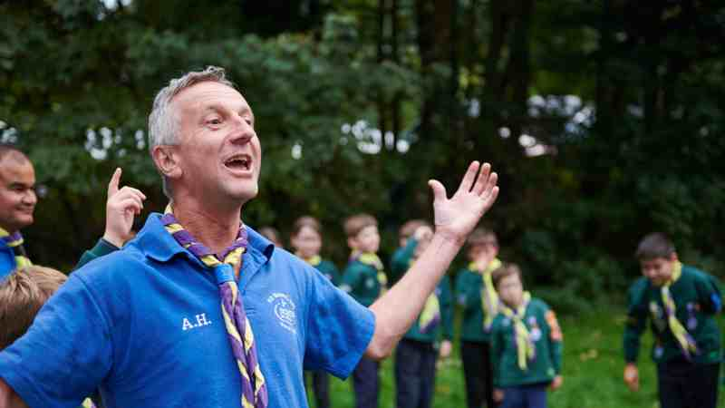
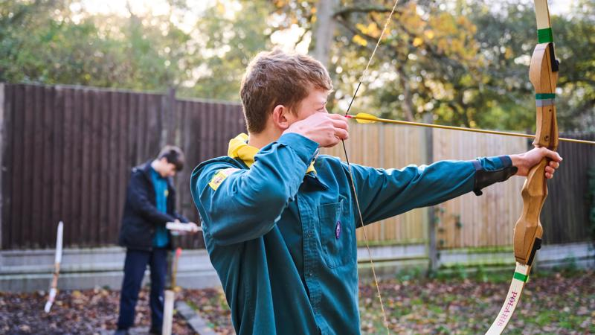
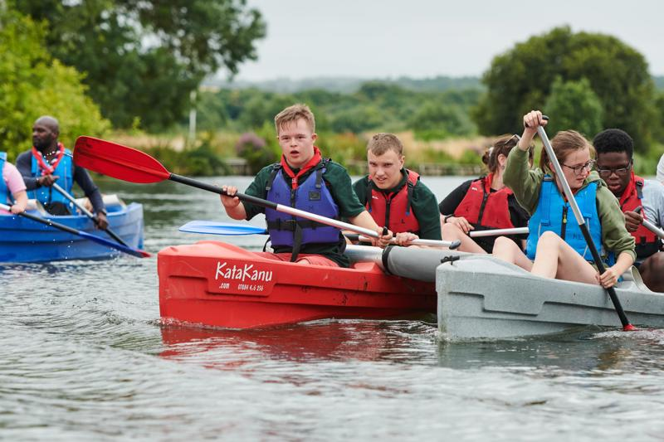
Headline Numbers
Northamptonshire County: 5880 Young People and 2050 Volunteers
Glendon District: 1200 Young people and 450 Volunteers
9 Groups in Kettering Town: 475 Young People 160 Volunteers
https://northantsscouts.org.uk/
http://glendonscouts.org.uk/

Slide 4
New Research: The Employability Badge
74% of Scouts alumni felt optimistic about getting what they want out of their careers, compared to 47% of people who didn’t do extracurricular activities. (27% Increase)
53% of those who went to Scouts felt prepared to start work for the first time, compared to 37% of people who didn’t take part in any extracurricular activities. (16% Increase)
60% of Scouts alumni agreed that taking part in extracurricular activities helped prepare them for their careers, in comparison to 49% of non-Scouts (including those who did other activities). (11% Increase)
Those who were in Scouts are gaining the skills employers most value, with more than half saying the teamwork and leadership skills they learned in Scouts help with their careers.
https://www.scouts.org.uk/scouts-and-employability/the-employability-badge-report/

Slide 5
Next Year in Scouting
Scouts Manifesto Launch Apr/May 2024
Our fresh approach to volunteering
Aligned Strategy to meet Skills for Life Strategy by 2025
Continued Expansion of Squirrels
Rejuvenation and Growth of Scouts and Explorers
https://www.scouts.org.uk/about-us/strategy/
https://www.scouts.org.uk/volunteers/volunteer-experience/volunteering-together/our-fresh-approach-to-volunteering/
https://www.scouts.org.uk/squirrels/
https://www.scouts.org.uk/volunteers/running-things-locally/grants-and-funds-for-your-local-group/grants-from-ukhq/uniformed-youth-fund-waiting-lists/

Slide 6
