Slide 2
Aims:
To support and encourage all forms of art and artists in the town
To offer low cost, high value events in the church spaces
To work with other organisations, artists and groups to see Kettering’s art scene grow.

Slide 3
Recent news

Slide 4
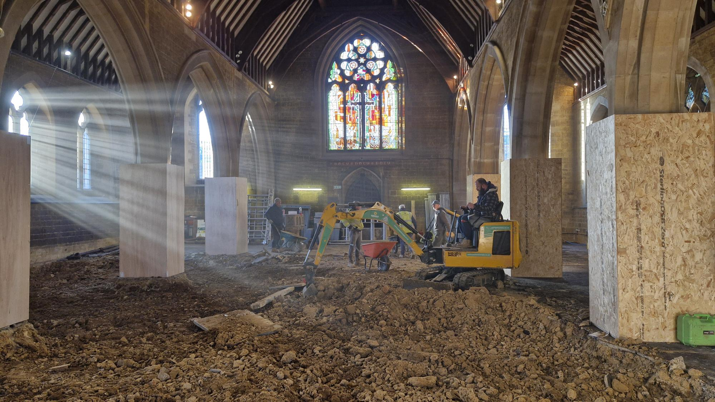

Slide 5
What will the project do
Underfloor heating
Accessible and flexible space
Upgrade technology and electrics
Larger stage with accessible ramp

Slide 6
Cost
£427,000 - total
£300,000 raised
from grants
£117,000 from donations
Still £10,000 to raise

Slide 7
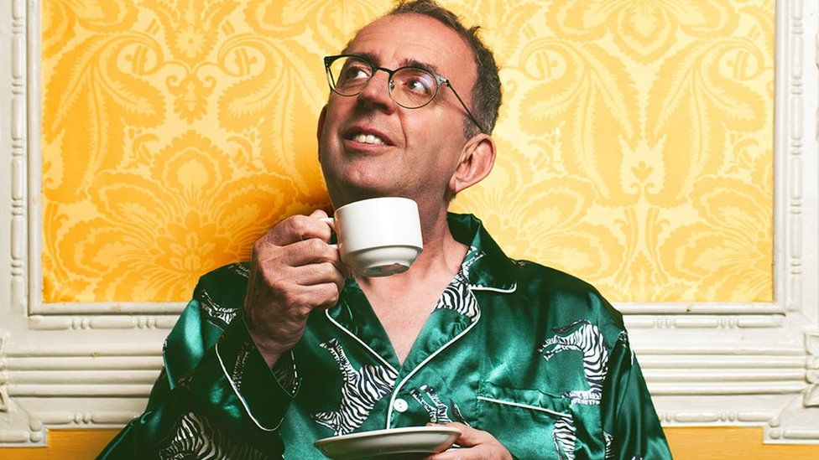
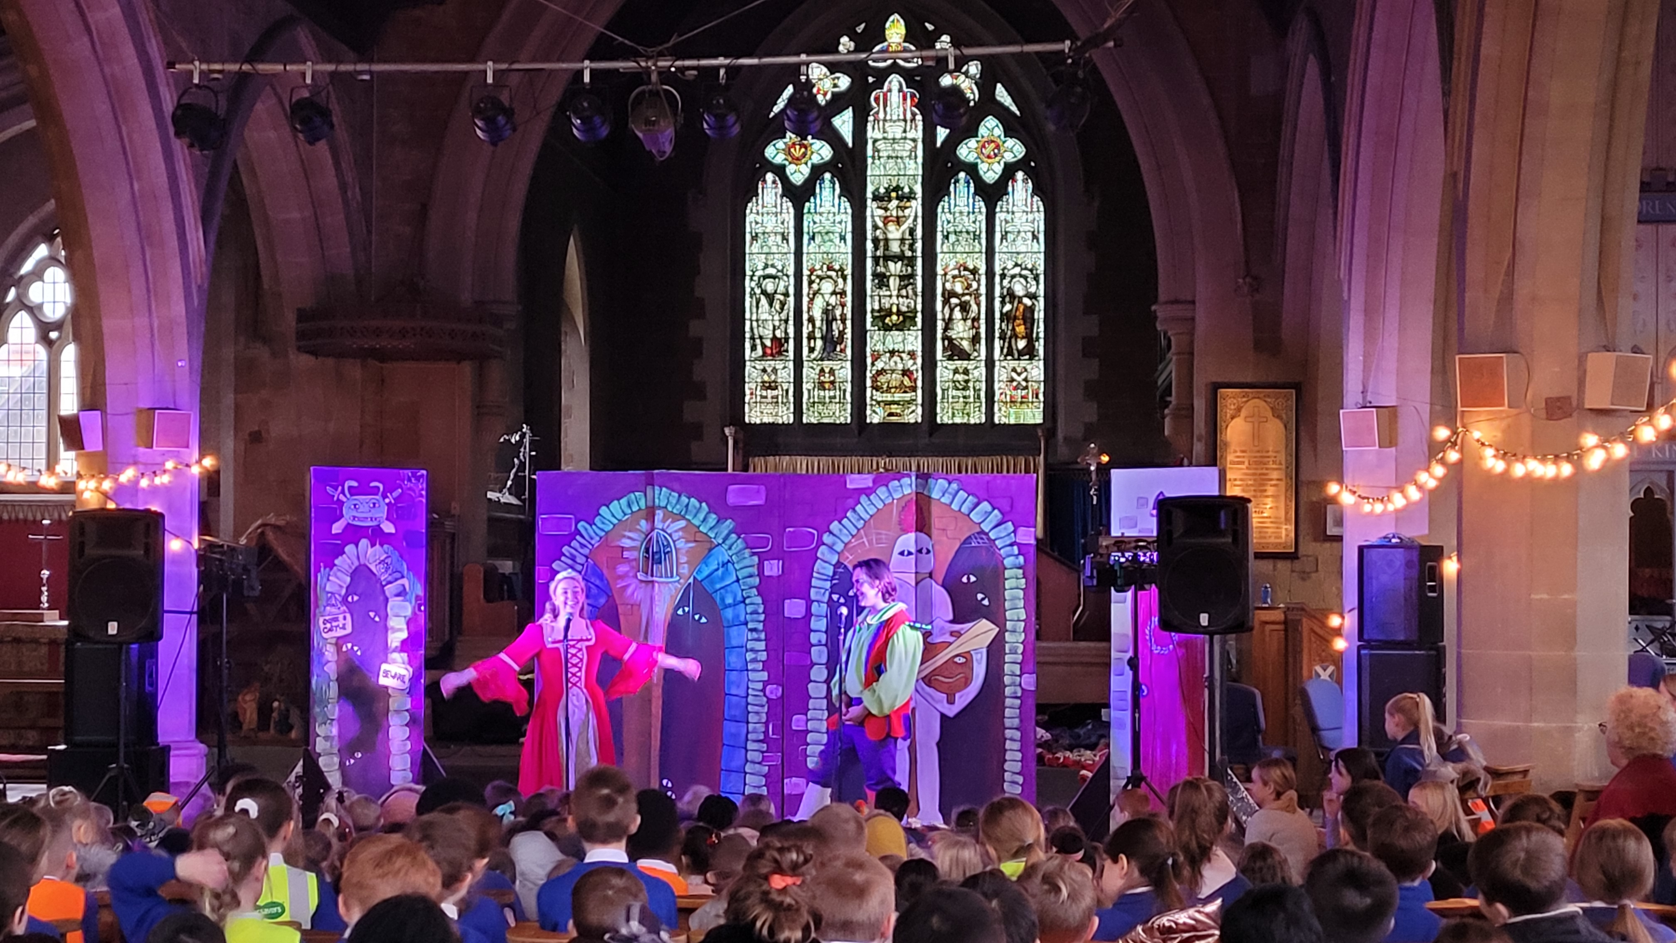
Richard Coles our new patron Soft reopen in June with Tresham art display, Kettfest, Have a go Arts day and Board game convention Full celebration in September Return of full events
In other news:

