Slide 1
Local Area Partnership
(LAP) Priorities
August 2023
N O R T H N O R T H A M P T O N S H I R E
northplacedevelopment@northnorthants.gov.uk

Slide 2
Local Area Partnerships: Summary
The following slides have been formed using the detail on the separate action plans for each LAP
Due to the priorities being the same, with similar outcomes, two slides have been merged
Wellingborough East and West
East Northants North and South
This does not mean that the LAPs have been combined, but merely demonstrates a representation of the similarities across the boundaries
The outcomes & outputs for the priorities were decided by the multi-agency task action groups, which consisted of elected members, statutory organisations and the voluntary and community sector
There is funding available to support the groups to produce the outputs which will improve the local communities, with outputs being considered in either a 3-month or 6-month timeframe
Asset mapping is still an ongoing process

Slide 3
Kettering Urban: Engagement with Young People
Improving Community Health and Wellbeing
-Presentations at task groups
-Email circulation list – contact details shared
Communication between services
Lead: North Northants Council Presentations: Police, Prospects, Gainn
Communication between services and young people
-Surveys created with recommended questions from task group
-Summer engagement using existing events, incentivised
Lead: North Northants Council Survey: All 23 attendees invited to provide questions – Prospects to review survey and suggest incentives
LAP Priority
Children & Young People: Improve engagement with YP regarding mental health and wellbeing
Lead: North Northants Council Engagement: All 23 attendees invited to attend engagement
YP awareness of services
- Freshers Fair (Tresham) – link provided
- Social engagement project (Grange) with stalls set up to promote local offers 10/08/23
- Awareness talks in schools/PRUs about youth safety & offers
Lead: Well Northants Involved: Green Patch/Groundwork, Gainn, Youth Works, Central COOP, NNC, Brightwayz, Grange Resource Centre
YP mental health & engagement
- Youth Mental Health Week (18th-24th September), utilising national Youth Mental Health Day (19th September)
- Existing offers and new events scheduled for the week
Lead: North Northants Council Involved: Illicit Skate

Slide 4
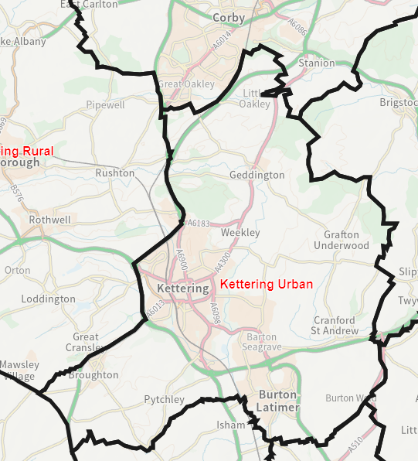
Kettering Urban Demographics
Aged 24 and under:
Kettering Town and West – 27.6%
Kettering Brambleside – 27.2%
Kettering South –
29%
Barton Seagrave – 29.9%
Kettering East –
25.8%
Burton Latimer – 30.4%
Kettering Avondale Grange – 34.3%
Geddington, Rushton & Stoke Albany (including Grafton Underwood and Cranford St Andrew) – 22.1%
Kettering Central East – 31.7%
Broughton, Mawsley & Loddington (including Pytchley) – 28.5%
Local Authority Health Report 2018
Population 78,900
(rounded to nearest 100)

Slide 5
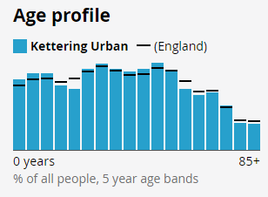
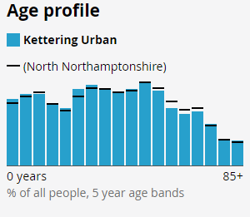
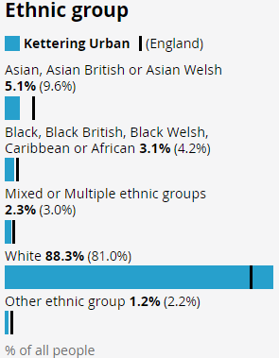
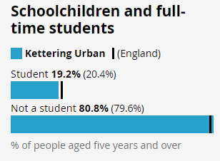
Kettering Urban Demographics
Above England average for 0-14 years
Population 78,900
(rounded to nearest 100)

Slide 6
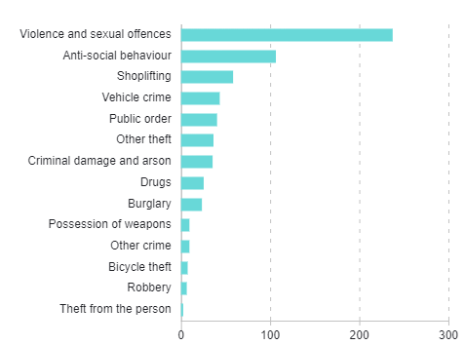
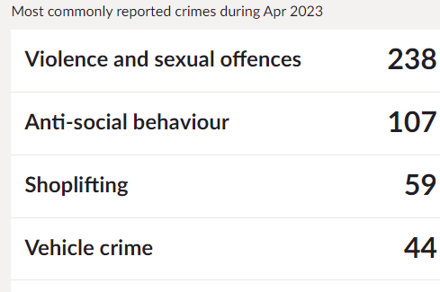
Kettering Urban Crime
Kettering Town
Population 78,900
(rounded to nearest 100)

Slide 7
How to get involved
Community Wellbeing Forum 12:30-2:30 pm
September 7th Cornmarket Hall
December 7th
Local Area Partnership (LAP) 6:30-8:30pm
28th September
26th October
23 November

Slide 8
Kettering Rural LAP: Breaking down barriers to services
Improving Community Health and Wellbeing
Communication between services
Contact details shared via task group consent form, circulation list created
Collaboration between services, e.g. Rushton Comm bus attending ACRE friendship visits
Local library visits
Email: All consenting partners
LAP Priority
Breaking down barriers to services
Understanding of local needs
Consultation of residents using survey & informal engagement
Data collected from local organisations
Lead: North Northants Council Involved: Accommodation Concern, Mind, ACRE, Brightwayz
Promoting local services
Services brought to rural locations using ‘one-stop-shop'
Lead: North Northants Council Involved: Police, Accommodation Concern, Mind, Central COOP, Alcoholics Anonymous, North Northants Council, Brightwayz, ACRE

