Slide 1
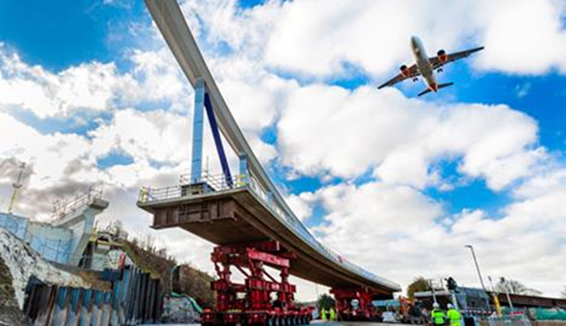

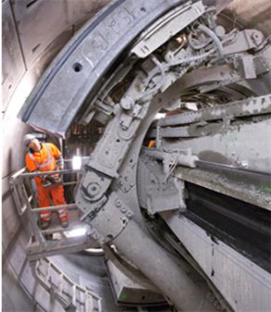
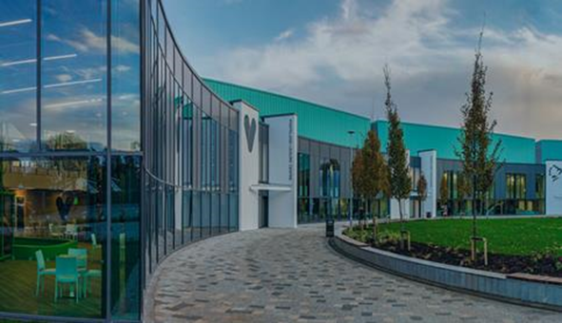
NNC/ Kier – Kettering Town Council
Wednesday 17th January 2024

Slide 2
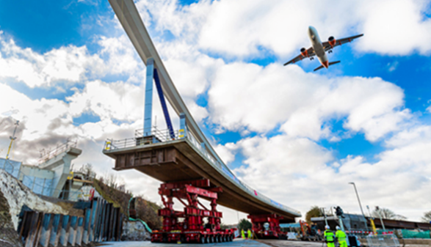

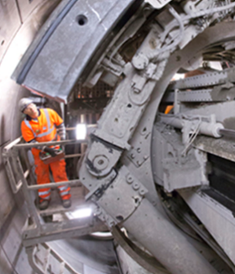
Agenda
Introductions
Holistic Evaluation and Assessment Tool (HEAT)
Repair Timescales (Safety Defects)
Street Doctor/ FixMyStreet Process
Customer and Communication
Questions

Slide 3
The team this evening
Graeme Kane - Executive Director Place and Economy (NNC)
Rob Carroll – Operations Manager (kier)
Jon Sutton – Customer Experience Manager (Kier)

Slide 4


North Northamptonshire
Highways
Asset Modelling & Prioritisation

Slide 5
HEAT

Slide 6
Categories, Weightings and Prioritisation Factors for Ranking Asset Needs/Schemes

Slide 7
Modelling, visualising and prioritising
Survey Data
CW/FW Survey (Gaist)
Skid Resistance (SCRIM)
Deflectograph
Inventory
Asset Data (PGR/VRS/Signs etc)
Scenario
Analysis
Asset Performance
Other Data
Defect clusters
Public Complaints / Claims
Hierarchy
Schools / Hospitals / Commercial areas
Resilient Network
Traffic Data
Works Done Records
Drainage
API Integrations
H.E.A.T
Maintenance Strategy
Investment Strategy
Visualise Assets
Multi-Year Works Programmes and Scenario analysis

Slide 8
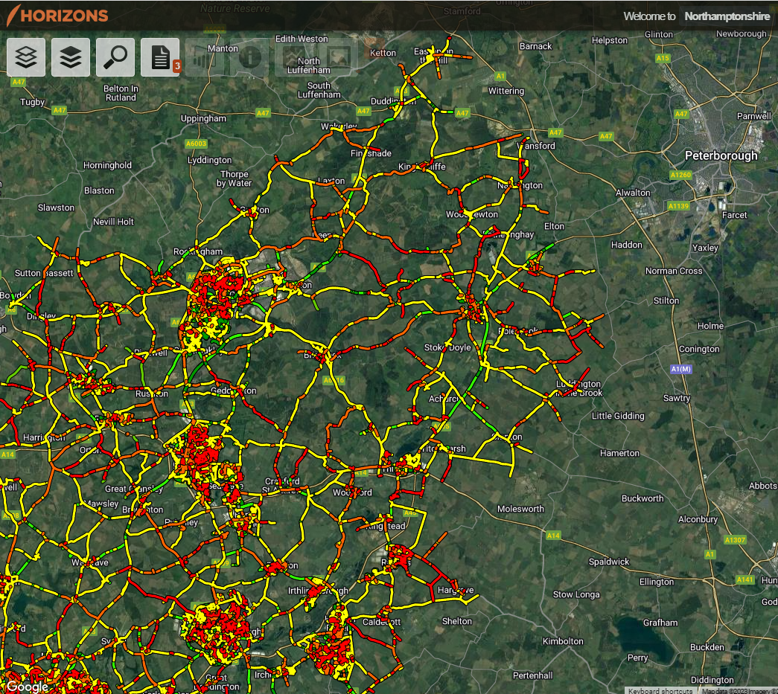
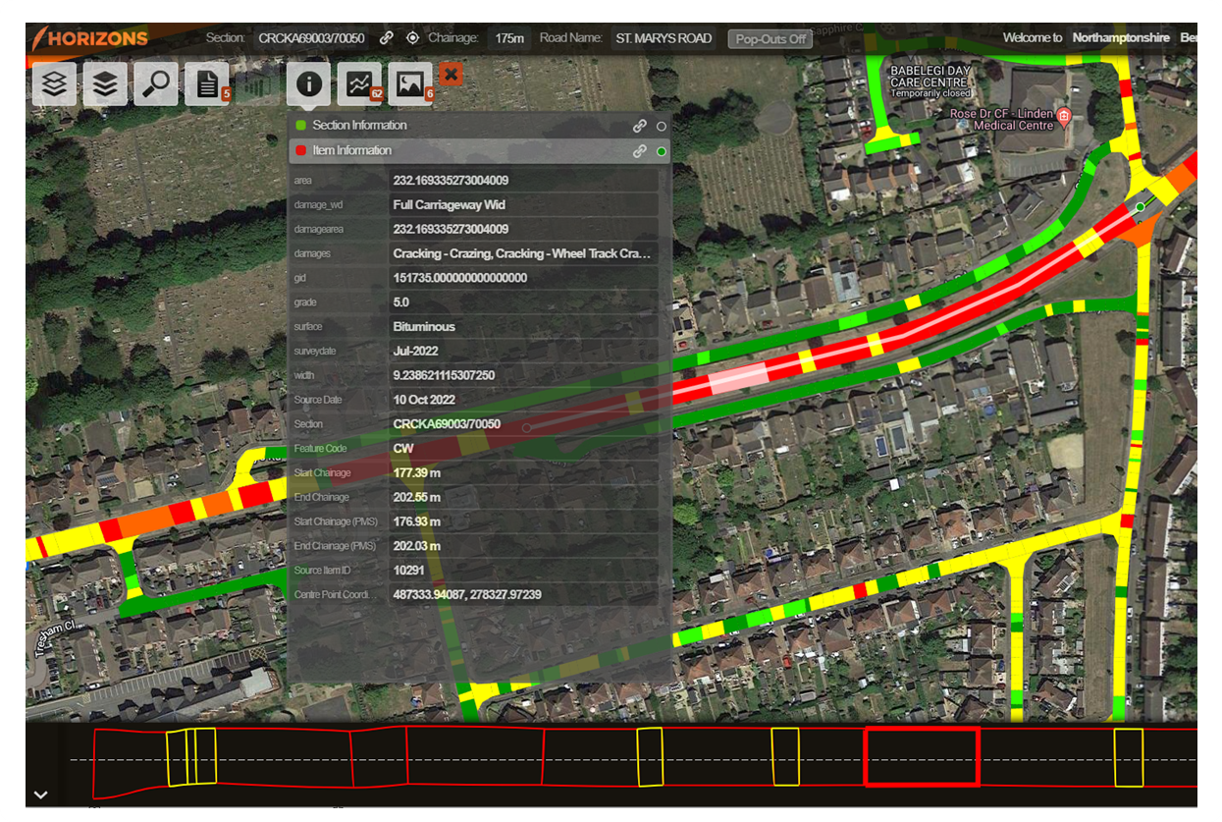
Visualising carriageway condition data

Slide 9

Repair Timescales

Slide 10
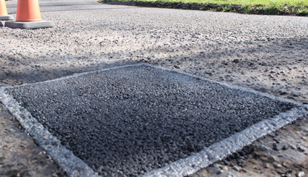
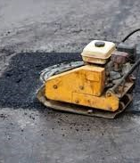
Repair timescales
P1 – 24 Hours – High Risk - pose a high risk and hence require a quicker response to repair following the risk based assessment undertaken by the Highway Safety Inspectors. If in the judgement of the inspector the defect is considered to represent a significant or imminent hazard, repair or make safe within 24 hours. If the defect can only be made safe within 24 hours we then carry out a permanent repair within 28 days (P3).
P2 – 7 Calendar Days – Medium to High Risk - following the risk based assessment undertaken by the Highway Safety Inspectors, require a repair within the 7 calendar day timeframe
P3 – 28 Calendar Days – Low to Medium Risk - deemed to carry more risk than P4 defects and hence require a speedier repair following the risk based assessment undertaken by the Highway Safety Inspectors
P4 – 26 Calendar Week Repairs – Low Risk - fall within investigatory levels however they are deemed to carry a low level of risk, hence being given longer following the risk based assessment undertaken by the Highway Safety Inspectors, for a repair to be undertaken.

Slide 11
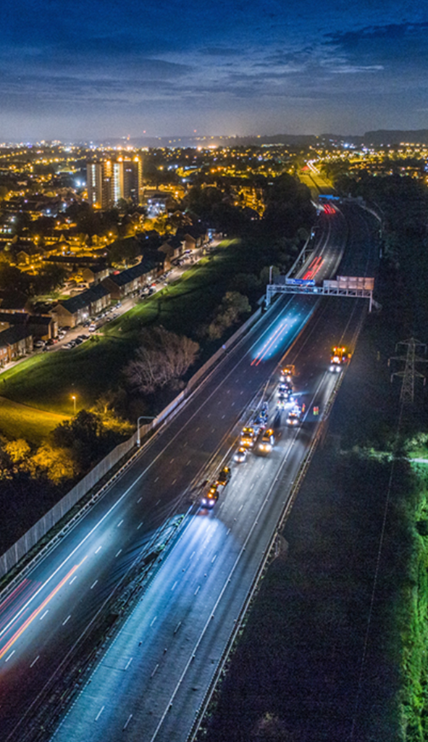
Our average repair times
P1 (24hrs) – average completion time within 24hrs
P2 (7 days) – average completion time 2.9 working days
P3 (repair within 28 working days) – average completion time 10.3 working days
P4 (repair within 26 weeks) – average completion time 10.8 weeks

Slide 12

Street Doctor/ FixMyStreet

Slide 13
The Street Doctor/ FixMyStreet Process
Street Doctor is the councils front facing page for public enquiries that links into FixMyStreet Northamptonshire. They are one in the same.
Report is logged
Report is investigated within 5 working days
Emergencies can be reported by phone
We will ascertain what needs to be done
We will report back what we intend to do and timescales
If we will not be addressing, we will tell your clearly why
If it is the responsibility of another organisation, we will report for you and provide report number details
Please share Street Doctor information with residents and constituents.

Slide 14
Customer and Communication

Slide 15

Customer and Communication
Customer focused and informative
Reporting
Street Doctor
Social media (not to be used for reporting)
X @nnchighways
Facebook @nnchighways
Traditional media
Press
newsletters
Digital
Website
Email bulletins
One.network
Works programmes
Events
Engagement sessions- online and in person
Scheme focus groups
Briefing sessions
Evaluation
Postcard and online customer surveys
Parish surveys
Compliments
Notes:
Simple way of reporting
Public talk to one person
Informed close outs
Better team knowledge
More direct route to solution
Wider promotion of service
Improved confidence in service - members and the public.
Please use the authority Street Doctor link
Street lighting: Please note that there is a separate pathway to
report faulty street lighting, directly to Balfour Beatty.
During office hours : You can also call to report a fault on 0800 0850257
lightingnorthamptonshire.com/report fault.aspx

Slide 16
