Slide 2
We are a Charitable Incorporated Organisation that delivers education and support services to the young people of Northamptonshire under 4 key strands:
Youth Works Northamptonshire

Slide 3
~ 1:1 Counselling and Emotional Wellbeing Support to 11-18* year olds ~ Rapid Response Counselling to 11-18* year olds – with contact made within 48 hours of an A&E visit and first session within 7 days ~ Wellbeing Cafes – offering drop-in support to young people aged 11-18* and their families ~ Family Support * We can work with young people with additional needs up to the age of 25
We are commissioned by the Northamptonshire Integrated Care Board (ICB) and Northamptonshire Health Foundation Trust (NHFT) to provide:

Slide 4
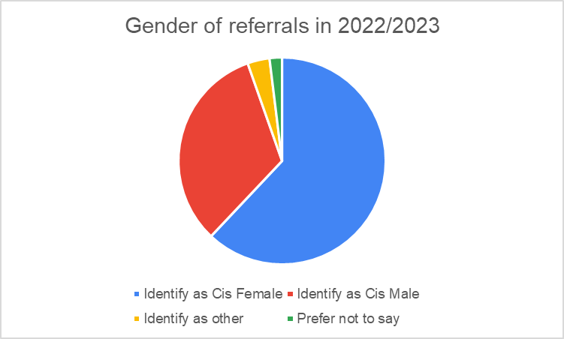
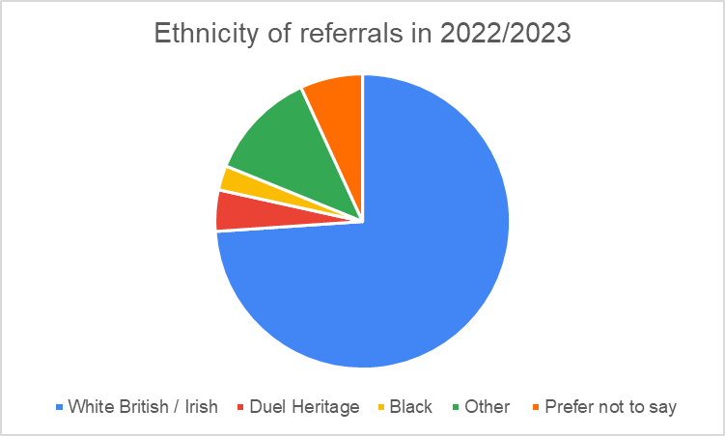
2022 / 2023

Slide 5
Rapid Response 2022 / 2023 Supporting young people who have presented in A&E and who need urgent support. We will make contact with these families within 48 hours and the young person will have their first counselling session within 7 days.

Slide 6
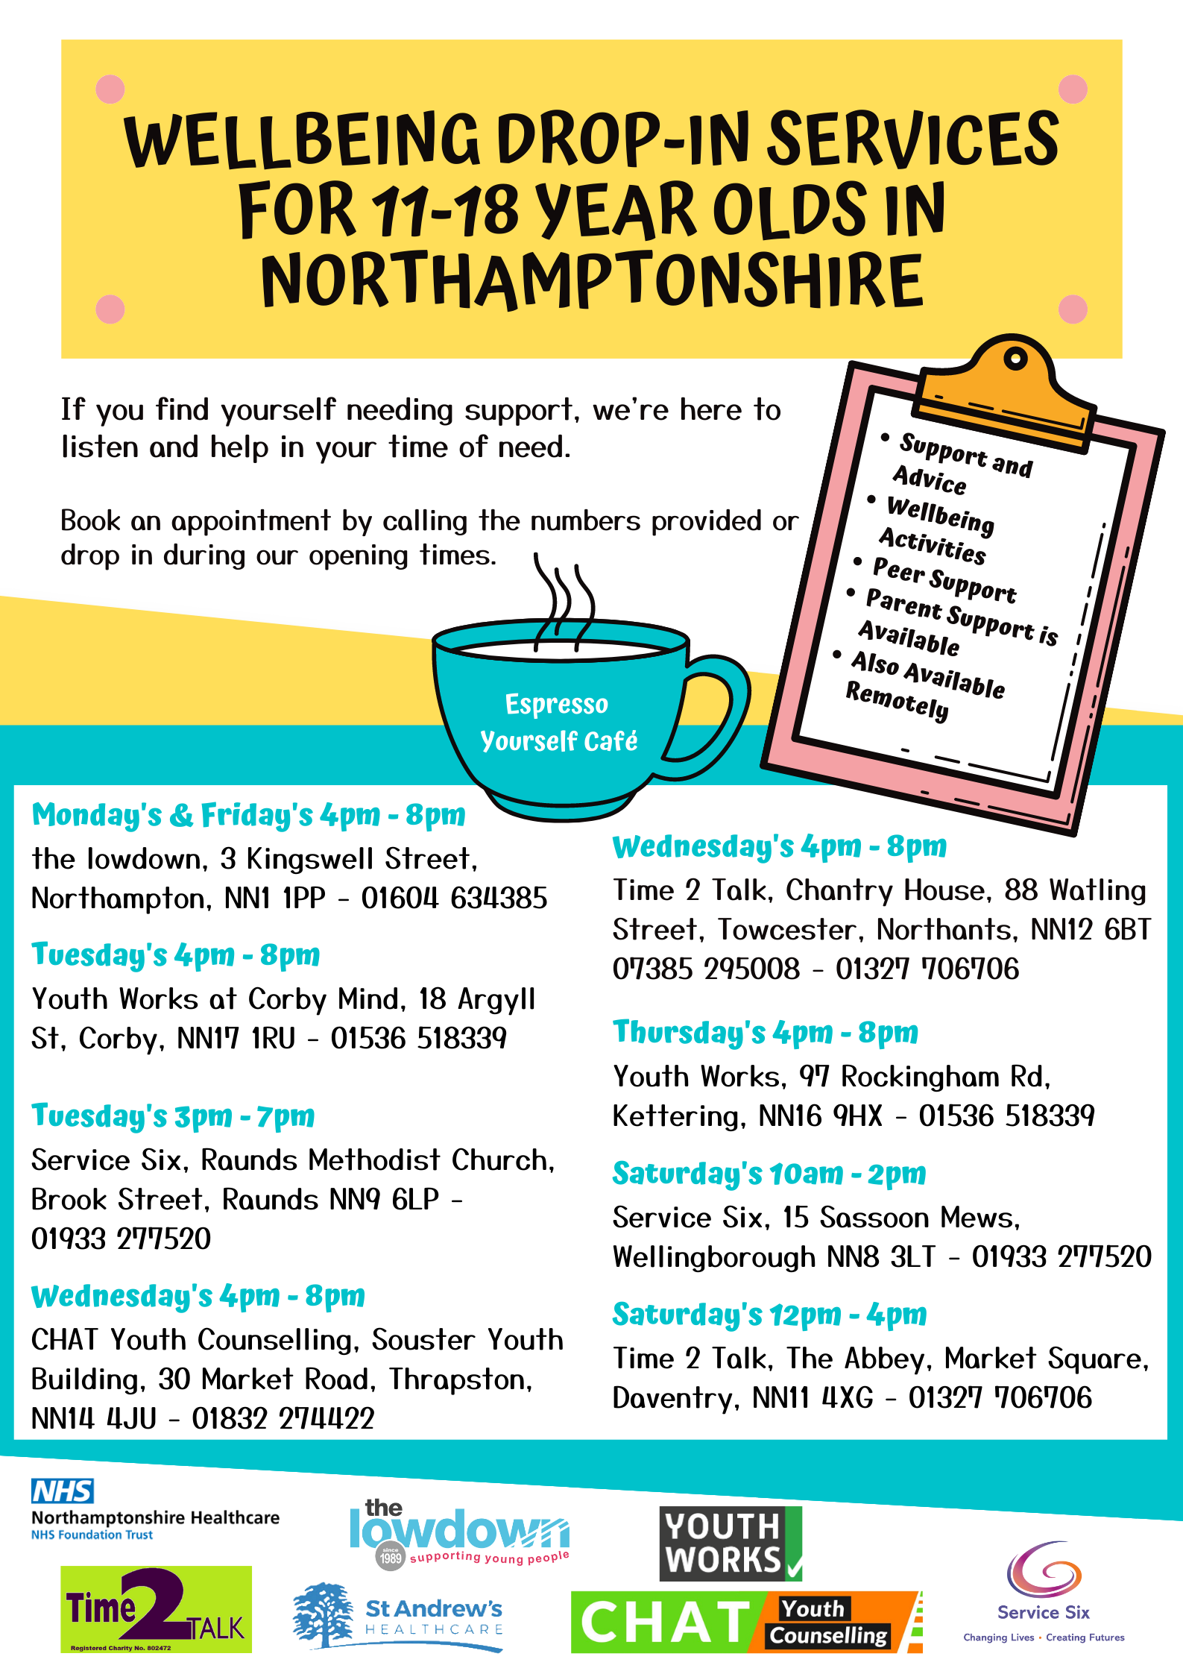
Wellbeing Cafes - Kettering & Corby 2022 / 2023

Slide 7
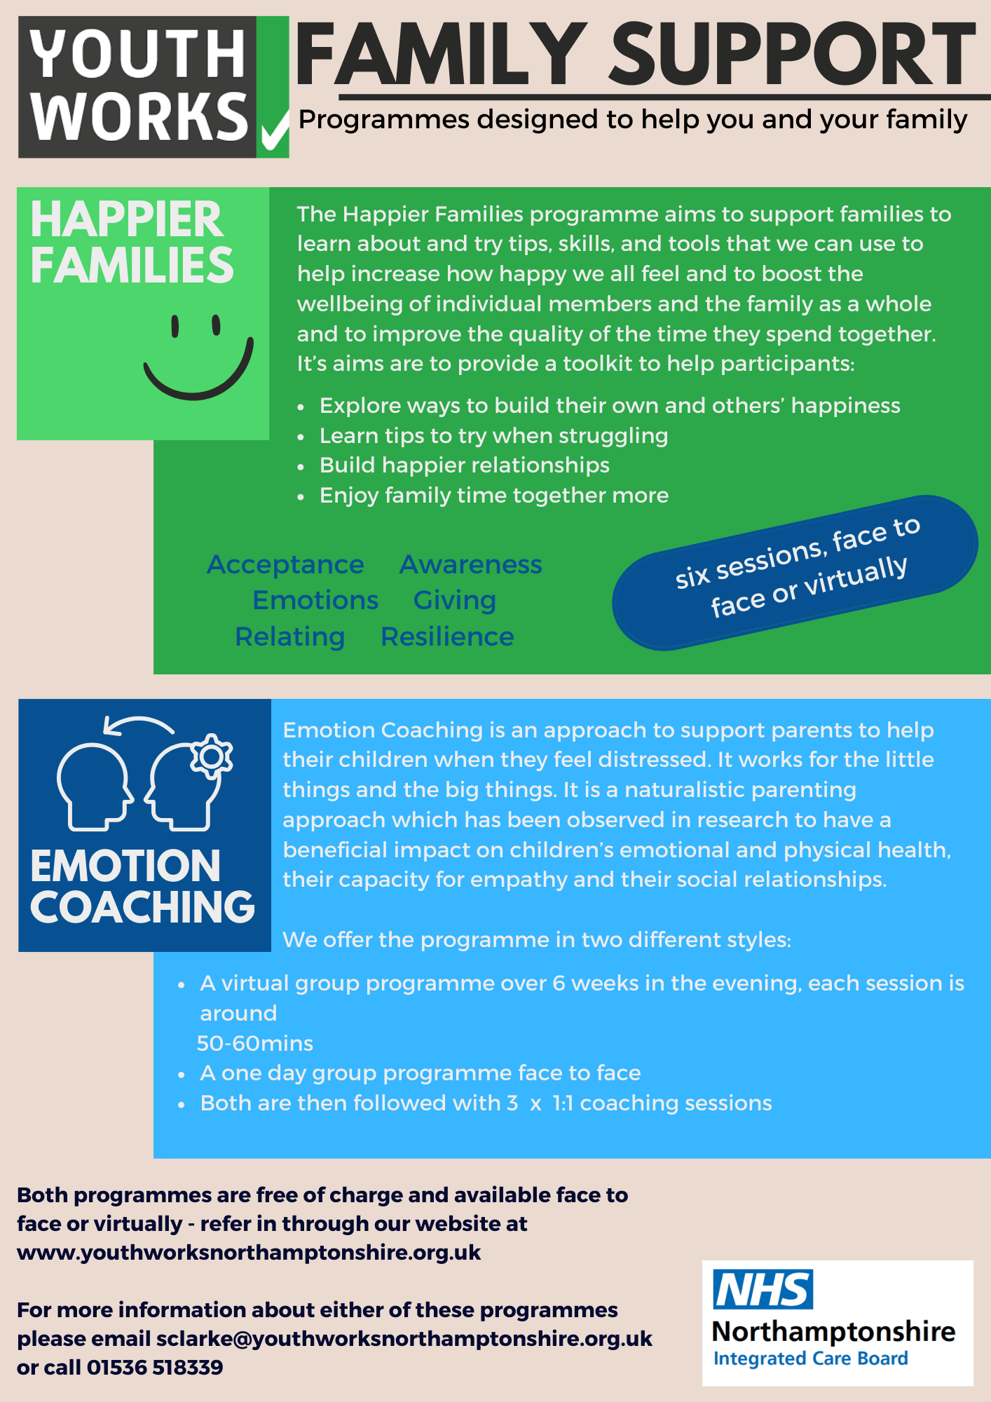
Family Support
Offered across Northamptonshire

Slide 8
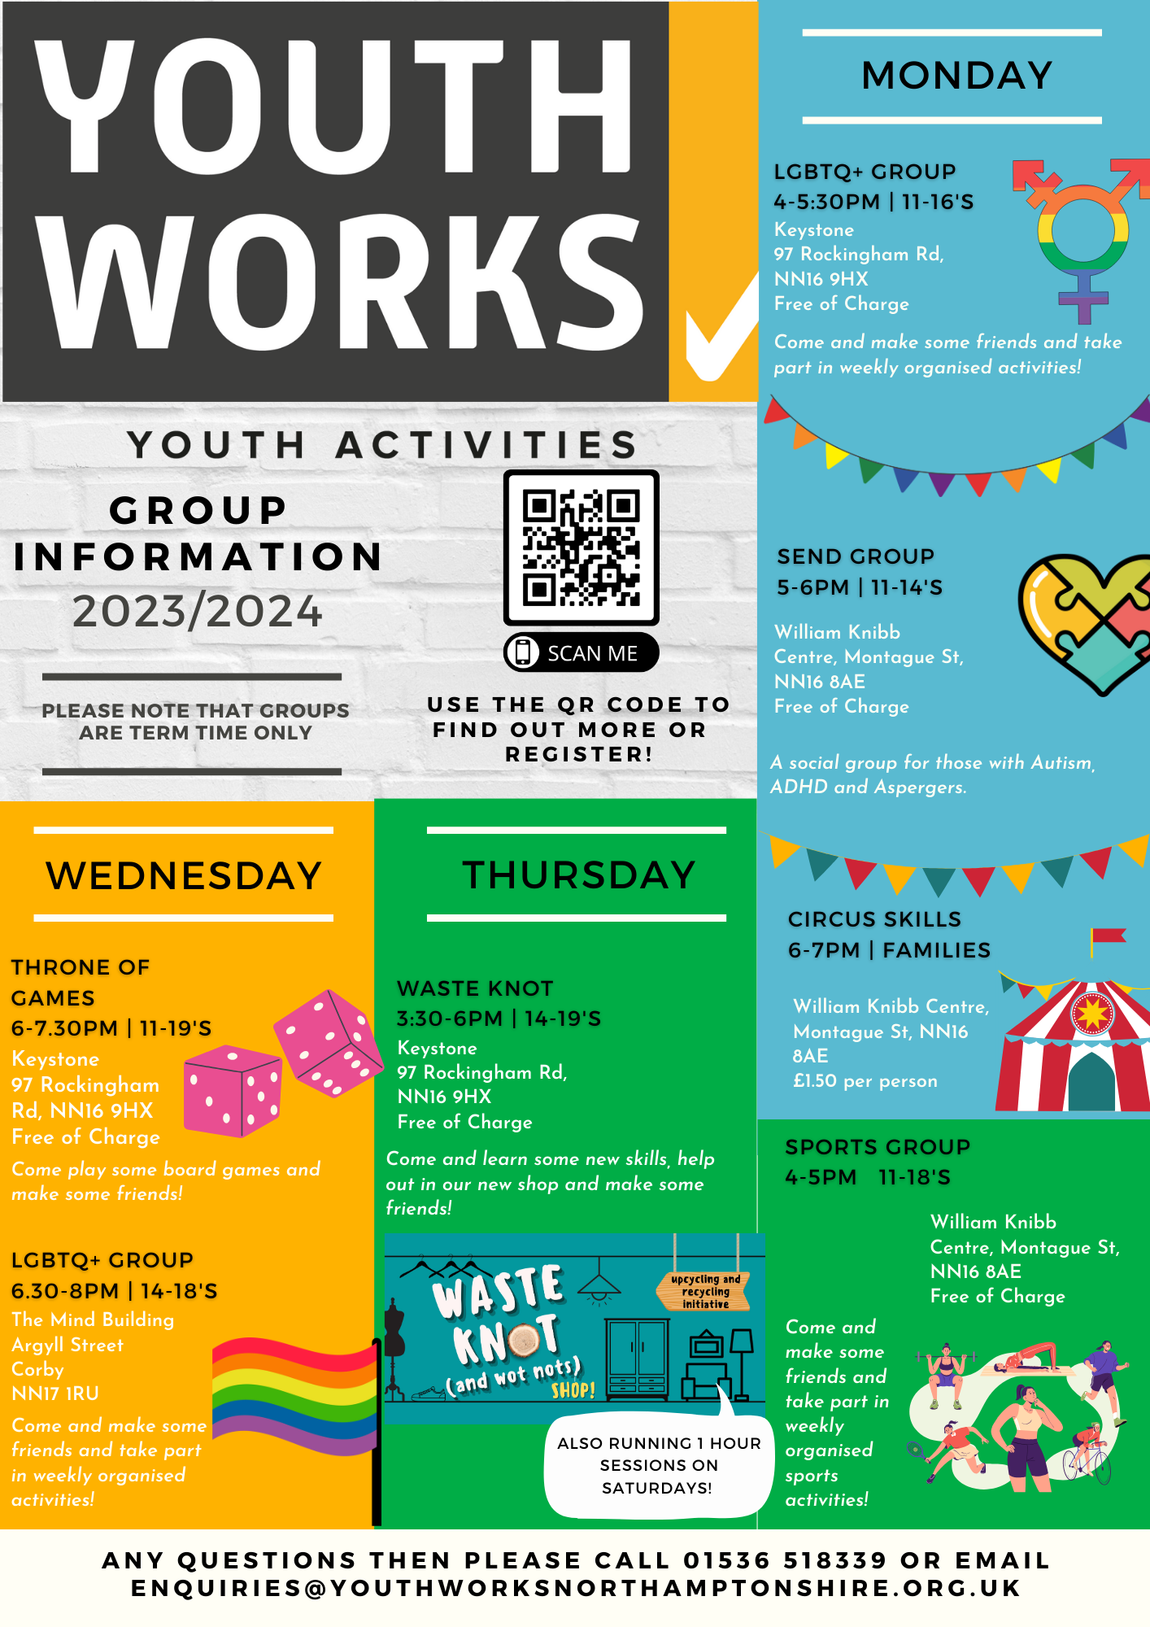
We offer 6 different weekly activity groups for young people in Kettering: LGBTQI+ SEND Circus Skills Throne of Games Waste Knot Sports Offering friendly safe spaces for young people to socialise, make friends and learn new skills

Slide 9
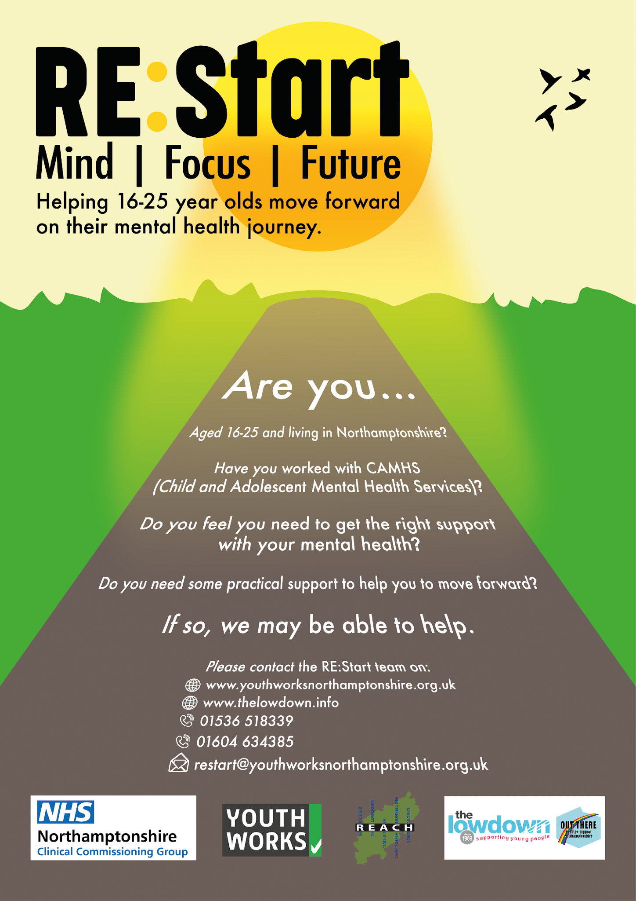
Providing practical support for young people aged 16 to 25, transitioning from CAMHS to Adult Mental Health Services
In 2022 / 2023 in North Northamptonshire

Slide 10
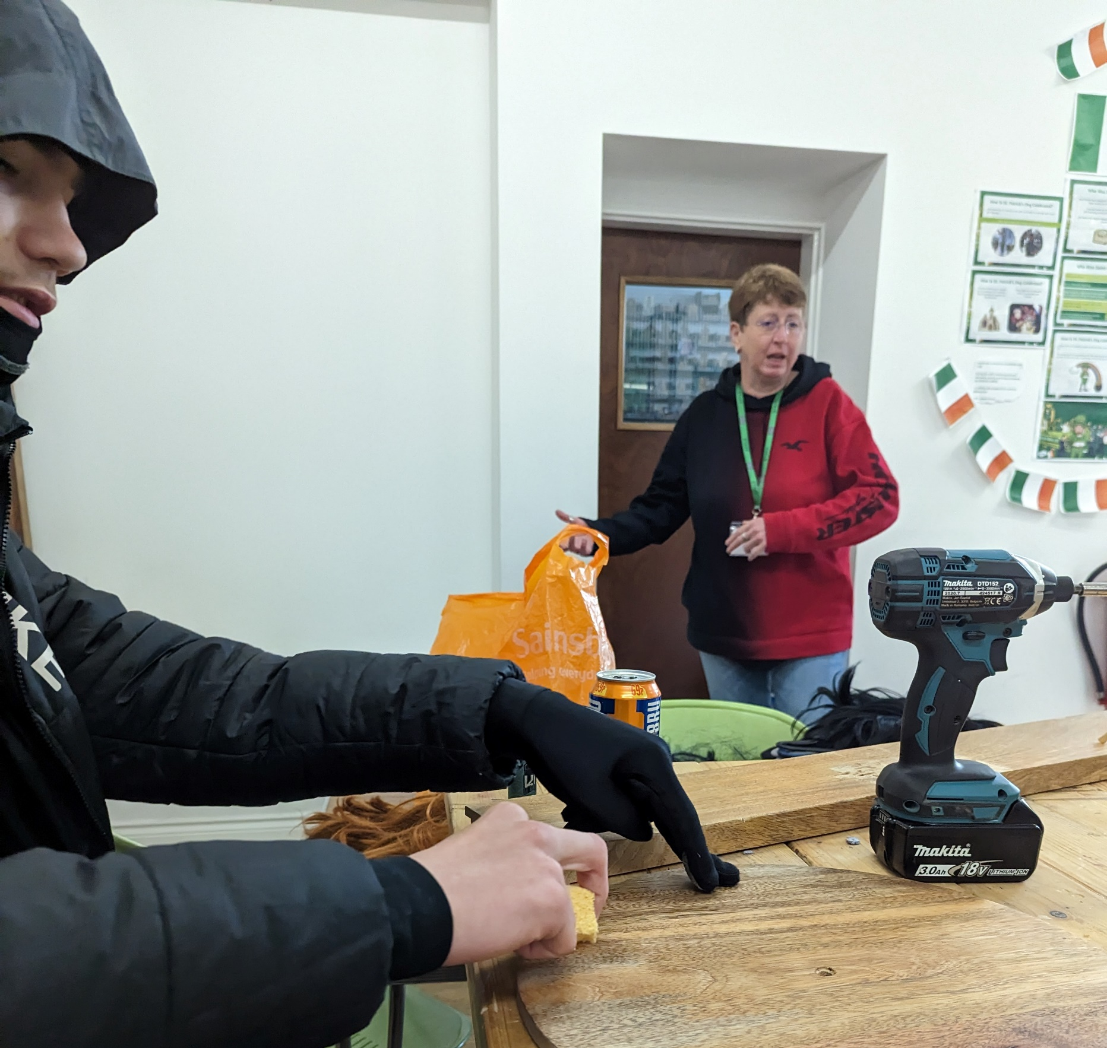
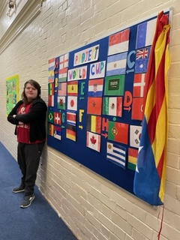
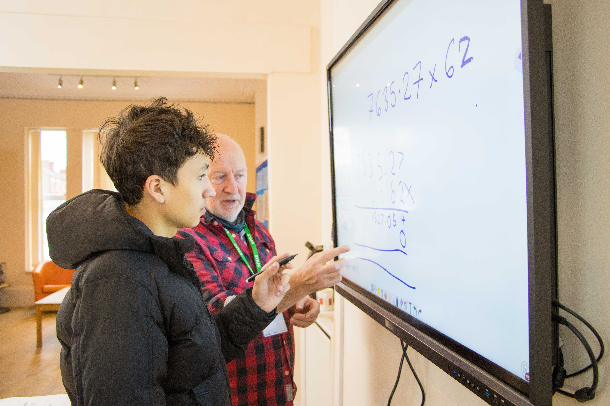
We are an Independent School offering alternative education for year 10 & 11 students not thriving in mainstream education. We support up to 20 students in years 10 & 11 working to re-engage learners who are at risk of educational and/or social exclusion and to provide learners with opportunities to achieve success and fulfil their potential

Slide 11
In 2022 /2023 :
573 Young people living in Kettering accessed Counselling
57 Young people living in Kettering received Rapid
Response Support
160 Young people living in Kettering visited the Drop ins
41 Families living in Kettering referred in for family
support
76 Young people attended activity groups in Kettering
And this year
7 Young people living in Kettering are attending our
school (7 from Corby and 3 further afield)

